Slide 1

Forte Hotel Design Project
Krish Weragalaarachchi
Kansas State University

Slide 2

Introduction
Forte Hotels, the largest United Kingdom’s hotel chain, is developing a new hotel chain in the United States mainly targeting European business people who come to United Sates for business.
Forte’s strategy in developing the new chain, named Forte Executive Innes, is twofold.
Attract customers by ambiance of a European hotel
American functionality and convenience.
European business travelers in the United States will recognize the Forte name and associate it with comfort and service.

Slide 3
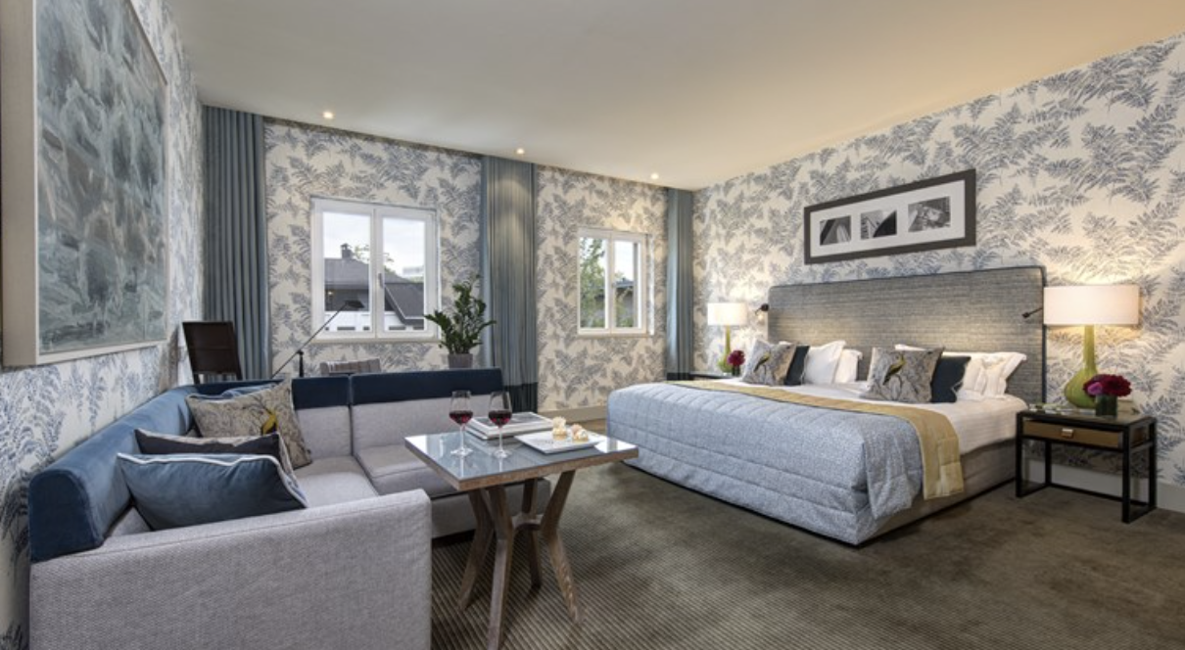
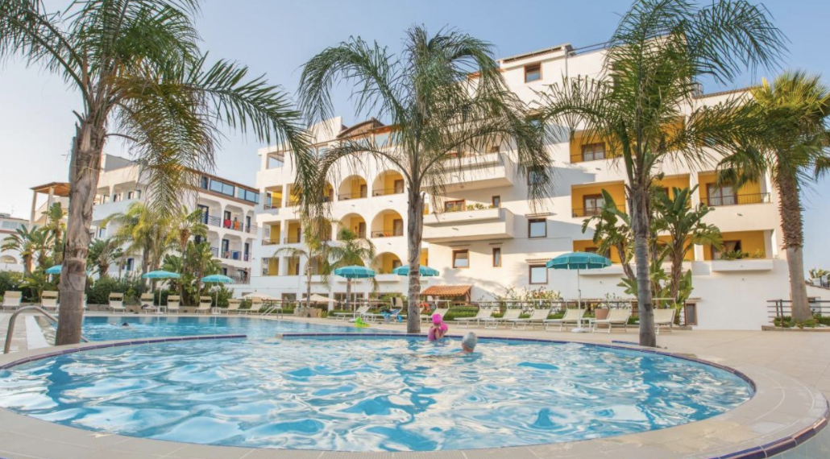
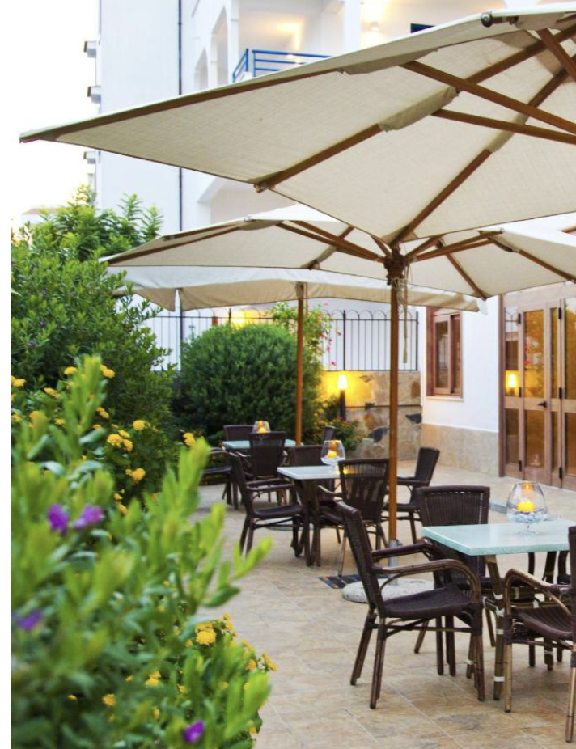
Objectives:
Find the most attractive feature among customers
Find most attractive amenity of each feature
Find the best bundle from the rated bundles for the competitive market.
Segment customers according to their preferences find the best group of customers to target.
Find competitors for the best bundle from new and existing hotels

Slide 4
Data :
Design data
Bundles :16 most valued bundles of rooms that were identified for customers to rate.
* All data, including column/row names were formatted to have no spaces and ‘+’ character for analysis.

Slide 5
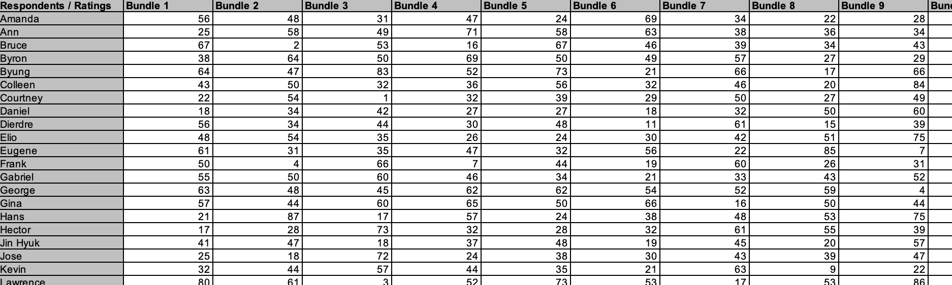
Data :
preference ratings given by 40 customers to 16 bundles.
* All data, including column/row names were formatted to have no spaces and ‘+’ character for analysis.

Slide 6
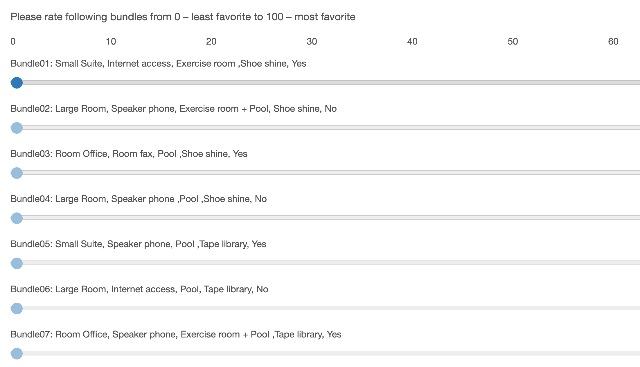
Survey Data:
https://qfreeaccountssjc1.az1.qualtrics.com/surveys/SV_eIP1iAIHIdzJwbQ/edit

Slide 7
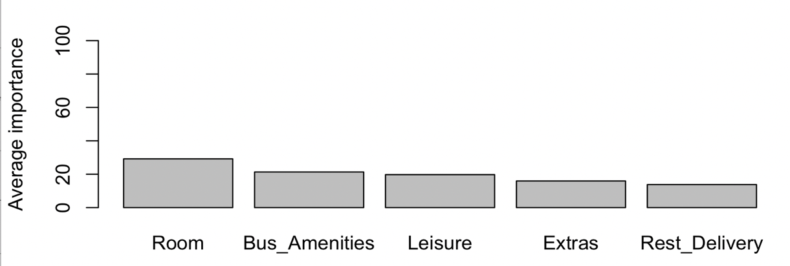
Conjoint Analysis (all respondents)
Partworth utilities for levels and importance of attributes for all respondents
Attributes | Level names | Partworth utility | Importance
Room | Small_Suite | 3 | 29.2
 | Large_Room | -3.2438
 | Room_Office | 0.2438
Bus amenities | Internet_access | -1.4687 | 21.32
 | Speaker_phone | 0.9063
 | Room_fax | 0.5625
Leisure | Exercise_room | -0.9979 | 19.74
 | Pool | 0.3896
 | Exercise_room_and_Pool | 0.6083
Extras | Shoe_shine | 0.1047 | 15.94
 | Tape_library | -1.2641
 | Fruit_and_cheese | 0.8859
 | Newspaper | 0.2734
Rest_Delivery | Yes | 0.0078 | 13.8
 | No | -0.0078

Slide 8
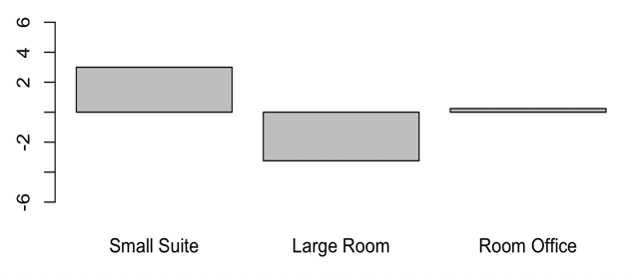
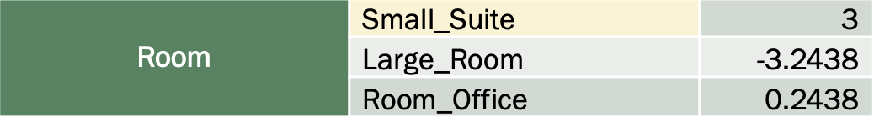
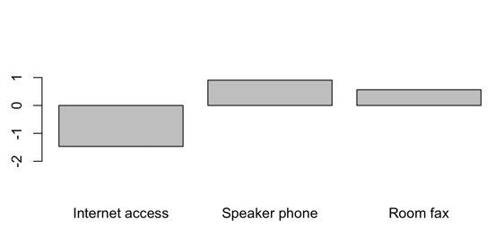
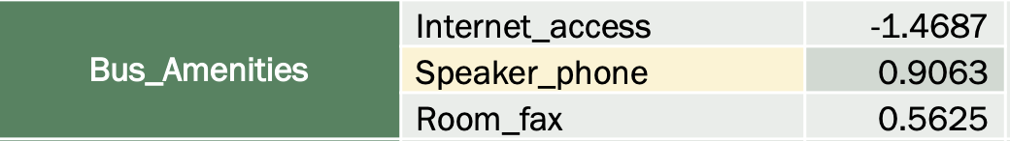
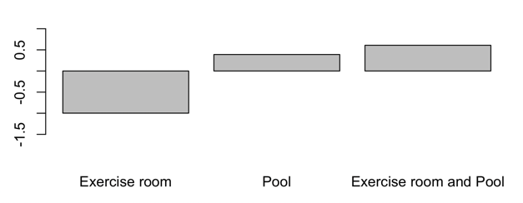
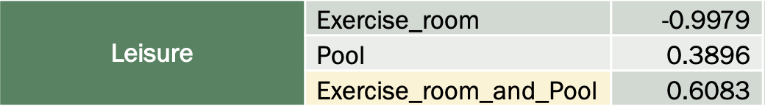
Part-worth utilities from Conjoint Analysis (all respondents)
Part worth utility of Small suite is 2.76 higher than Room office and 6.24 higher than Large room.
Part worth utility of Speaker phone is 0.3 higher than Room fax and 2.4 higher than Internet access.
Part worth utility of exercise room and pool is 0.2 higher than Pool and 1.7 higher than Exercise room.

Slide 9
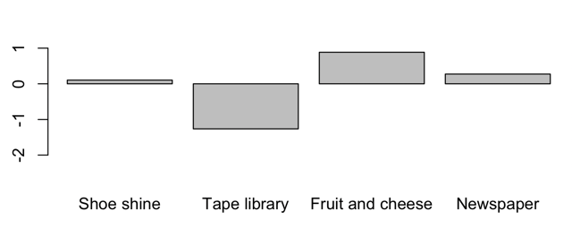
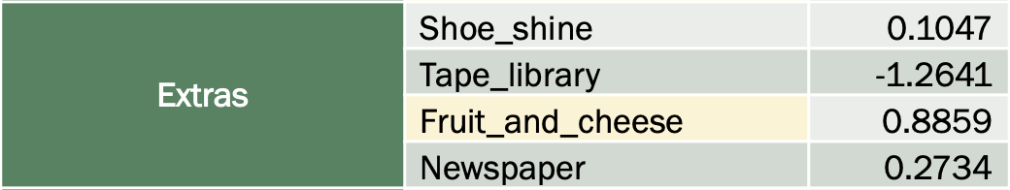
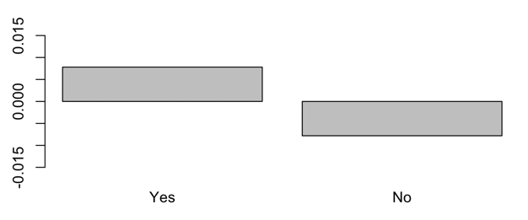
Ctd..
Part worth utility of Fruit and cheese is 0.6 higher than newspaper, 0.8 higher than shoe shine and 2.2 higher than Tape library.
Part worth utility of Restaurant delivery is 0.016 higher than no restaurant delivery.

Slide 10

Preference Share (for each bundle)
Pref_{i} = β₀+ β₁(Small_Suite)_{i} + β₂(Large_Room)_{i} + β₃(Room_Office)_{i} + β₄(Internet_access)_{i} + β₅(Speaker_phone)_{i} + β₆(Room_fax)_{i} + β₇(Exercise_room)_{i} + β₈(Pool)_{i} + β₉(Exercise_room_and_Pool)_{i} + β₁₀(Shoe_shine)_{i} + β₁₁(Tape_library)_{i} + β₁₂(Fruit_and_cheese)_{i} + β₁₃(Newspaper)_{i} + β₁₄(Yes)_{i} + β₁₅(No)_{i} + εi
Where β_{i} = Partworth utility of each level(considering all respondents)
εi = error term
 | Bundle 01 | Bundle 02 | Bundle 03 | Bundle 04 | Bundle 05 | Bundle 06 | Bundle 07 | Bundle 08 | Bundle 09 | Bundle 10 | Bundle 11 | Bundle 12 | Bundle 13 | Bundle 14 | Bundle 15 | Bundle 16
Preference score | 44.33 | 42.06 | 45.00 | 41.84 | 46.73 | 38.09 | 44.19 | 38.74 | 48.74 | 41.25 | 43.73 | 42.63 | 48.25 | 41.68 | 44.11 | 39.87

Slide 11
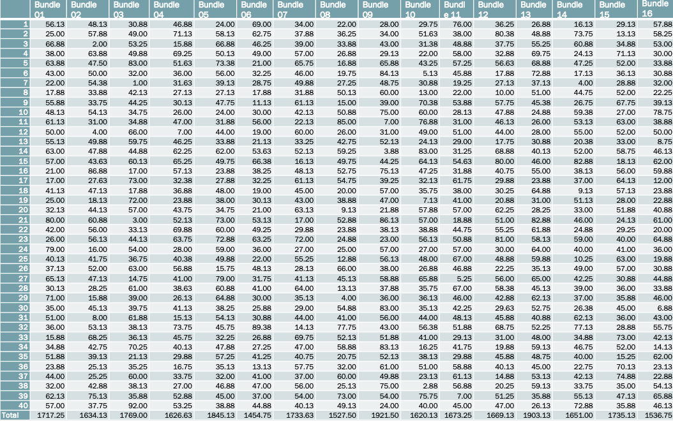


Total utility for each respondent (bundle choice)
The most preferred bundle for Elio (10th) : Bundle 16
The most preferred bundle for Nina (26th) : Bundle 08
The most preferred bundle of surveyed population : Bundle 09

Slide 12
Frequency of purchase
Bundle_name | Freq
Bundle01 | 3
Bundle02 | 2
Bundle03 | 6
Bundle04 | 1
Bundle05 | 2
Bundle06 | 1
Bundle07 | 1
Bundle08 | 2
Bundle09 | 6
Bundle10 | 3
Bundle11 | 3
Bundle12 | 2
Bundle13 | 1
Bundle14 | 2
Bundle15 | 4
Bundle16 | 2

Slide 13
The most preferred bundle
Bundle 09

Slide 14

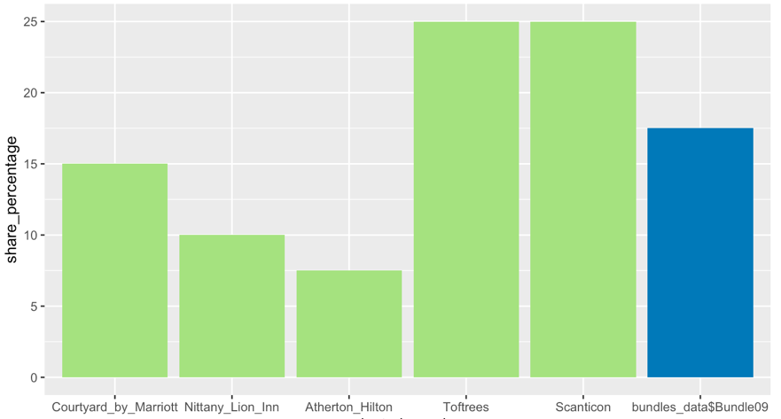
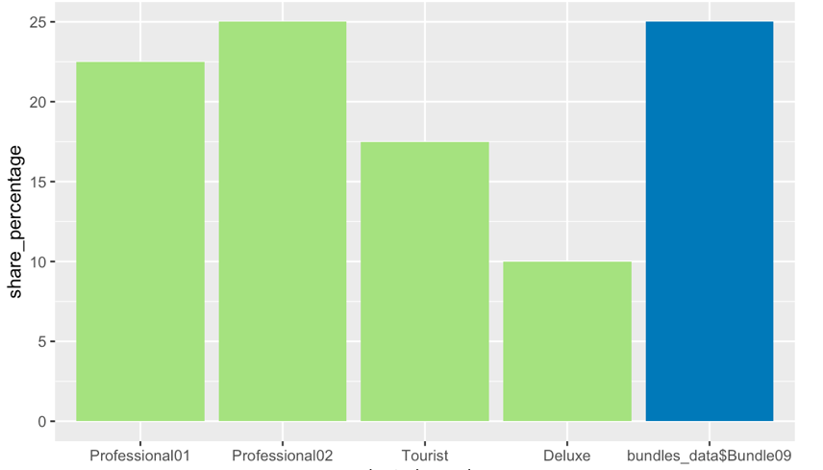
Market Share for Bundle09 (to identify competitors)
With existing 5 hotels
With new 4 hotels

Slide 15
With existing 5 hotels
With new 4 hotels
Attributes | Professional01 | Professional02 | Tourist | Deluxe | Bundle09
Room | Room_Office | Small_Suite | Large_Room | Large_Room | Small_Suite
Bus_Amenities | Internet_access | Room_fax | Speaker_phone | Internet_access | Room_fax
Leisure | Exercise_room | Exercise_room | Exercise_room_and_Pool | Exercise_room_and_Pool | Exercise_room_and_Pool
Extras | Fruit_and_cheese | Tape_library | Tape_library | Tape_library | Fruit_and_cheese
Rest_Delivery | No | Yes | No | Yes | No

Slide 16
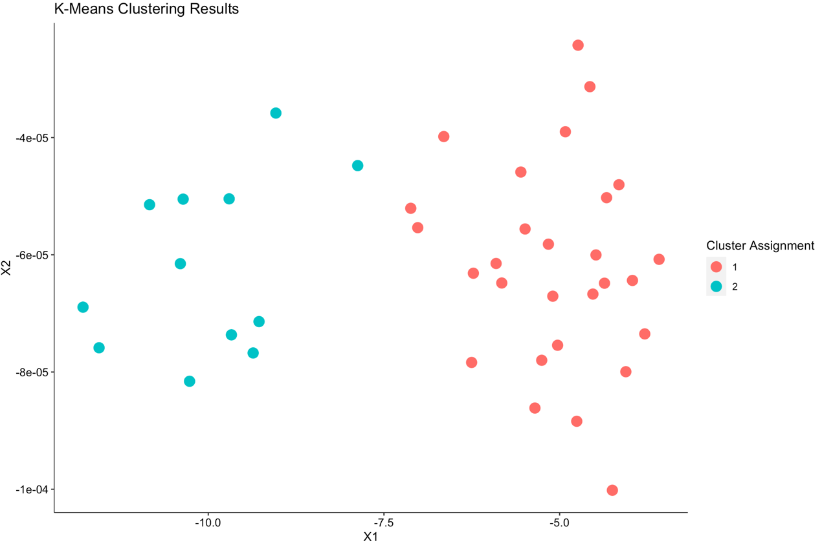
Market Segmentation (to identify target market)

Slide 17
Properties of segments
Step 1 : Comparison of Mean rating value of each bundle for each cluster with the overall mean
>> The main difference between two clusters is due to room type

Slide 18
Properties of segments
Step 2 : Conjoint analysis for 2 clusters

Slide 19
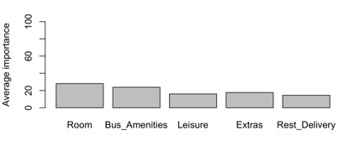
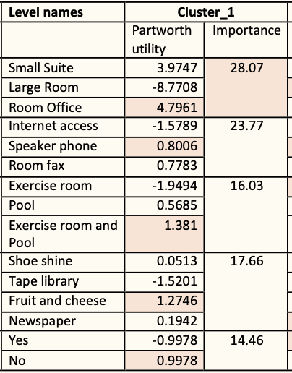
Properties of segments
Cluster_1 (Business)
Business amenities has higher importance
Room office (one bed, office desk) has higher utility score than other room types
Room fax has higher utility score(only 2nd to speaker phones)
Smaller pool and exercise room is preferred
Fruit and cheese and no restaurant delivery.
>> more independent, prefer small spaces, value their time, outgoing

Slide 20
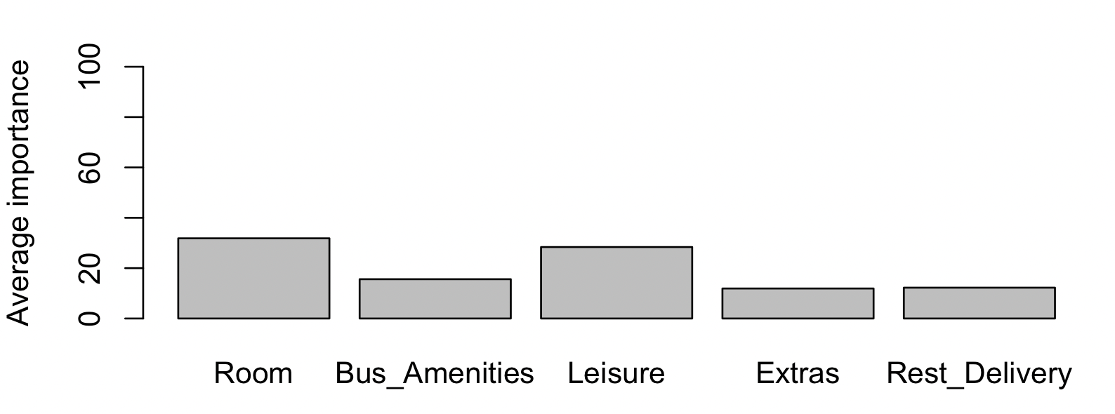
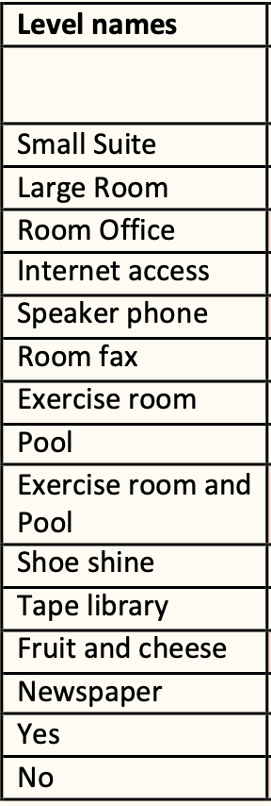
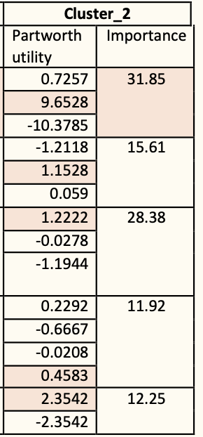
Properties of segments
Cluster_2 (Family/like to relax)
The most important attribute is room type and prefer large rooms with double queen beds.
Has higher importance on Leisure facilities over business amenities. Specifically well equipped exercise rooms. Pools with lap comes next.
Daily news paper delivery
Restaurant delivery via room service
>> value large spaces, leisure activities, news and easy access to different type of food.

Slide 21

Forte Hotel’s main goal is to target business people who comes from Europe to United States for business work and American business community. - Target Market should be Cluster_1 (Business)

Slide 22
Summary
The most attractive feature in the market - Room
In general, small suite, speaker phones, small exercise room and small pool combo, complimentary fruit and cheese bowl, and restaurant delivery via room service are most attractive amenities.
The most preferred bundle is Bundle 09 which includes
small suite,
room fax,
exercise room and pool,
fruit and cheese
no restaurant delivery
There are two segments in the market.
business class
family oriented / like to relax

Slide 23
Recommendations
In case of launching the most preferred bundle (Bundle 09) to the market which consists of existing hotels, Toftrees and Scanticon would be the biggest competitors to look for.
In case of launching the most preferred bundle (Bundle 09) to the market which consist of new hotel room bundles, Professional 02 bundle would be the greatest competitor.
Forte Executive Inn should be targeting the cluster_1 (Business class) as their goal is attracting European business class who travels to United Sates and American business class.

Slide 24
Thank you!

Slide 25
References
1.https://www.slideshare.net/MinhaHwang/conjoint-analysis-part-33-market-simulator
2.https://www.r-bloggers.com/2018/12/conjoint-analysis-understand-your-customer-and-beat-the-competition/
3. https://faculty.idc.ac.il/jgoldenberg/pdf/Conjoint.pdf

